Slide 1
Design a tool which uses weather forecasts to predict asset failure and deterioration
HackTrain VI
Jane Devine – Route Performance Analysis Manager, Scotland Region

Slide 2
Challenge on a page
Can we use weather data and historic asset failure information to build a model to pro-actively predict asset failure depending on weather conditions?
Problem: Network Rail have a hypothesis that asset reliability varies depending on atmospheric/weather conditions, such as temperature, precipitation levels, dry, ice, etc., but we do not have a model for predicting failures.
Hack Scope: Scotland’s Railway
Supplied Data: Historic weather data, 4 years of incident data for Scotland and asset locations.
Challenge sponsor: Jane Devine Region: Scotland

Slide 3
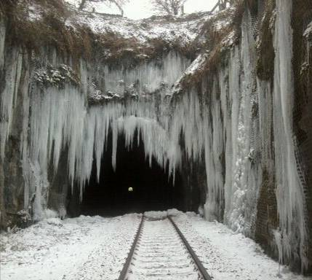
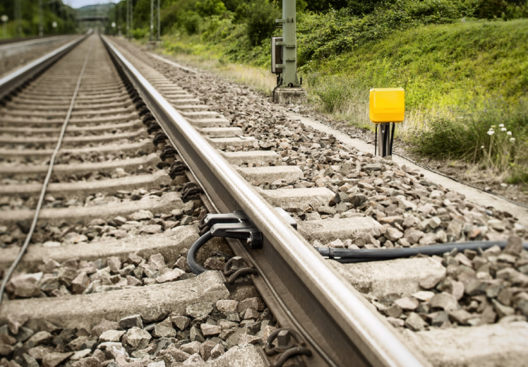
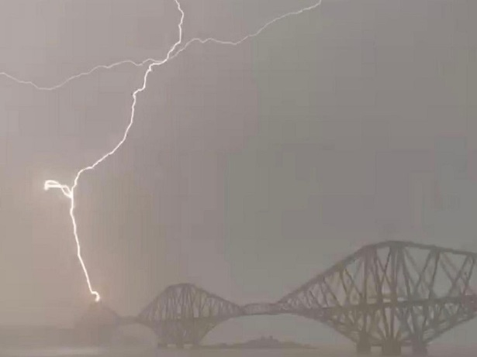
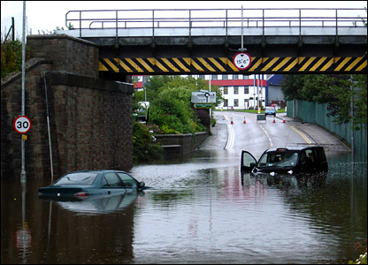
Asset failure caused by weather
Icicles forming on tunnel near Glasgow
Equipment such as Axle Counters could be impacted by atmospheric conditions?
Heavy rain may lead to failure of specific track circuits?
Thunder & Lightning may affect power supplies?

Slide 4
What does success look like?
Short term (for the hackathon):
Identify if there’s a correlation between weather conditions and specific incident codes in specific sections [Output #1]
Use fuzzy logic to identify from incident text & description which assets have failed in a section [Output #2]
Build a model where weather conditions can be input and problematic sections identified (as a stretch goal, specific assets!) [Output #3]
Medium term:
An inventory of assets which includes weather-based deterioration, linked to live weather forecasts.
Long-term:
To prepare targeted maintenance in advance of asset failure, taking into account current failure rates of that type of asset and that particular asset in conjunction with other external factors (such as weather)

Slide 5
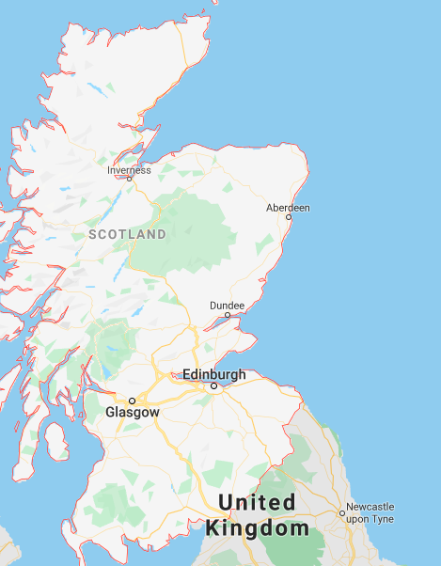
Geography for the hack

Slide 6
The data
Supplied Data:
Historical weather data
4 years of incident data from Scotland.
Location of sections geographically
Location of assets

Slide 7
Good Luck!

